Slide 1
Weekly report: Grid Code Development
Week number: 2
Date: 30/09/2025
Supervisor: Prof. Dr.-Ing. Saiju
Group members: Vijay Bogala, Josef Remberger

Slide 2
List of contents
Process plan
Grid operation states
PowerFactory learnings
Further work

Slide 3
1. Process plan
 1 week
 2 weeks
Identify modes of grid operation
According to PETE and DNV GL IV I
Design grid code, circuits & control circuits
Hand calculations
 1 week
Get feedback on
Grid code V2
Technological history
SIMULINK/SIMSCAPE
Refinement
Publish first draft
of report
Share with team and feedback
Analyze performance
PowerFactory simulations
 1 week
 1 week
 1 week
[1]

Slide 4
2. Grid operation states
Normal operation
Definition: TSO reasonably expects that the demand for that day will be met by available capacity with a contigency reserve without the need for load shedding
Frequency: 49.90-50.10 Hz
Voltage:
59.5-72.5 kV (±10 %)
207-241.5 kV (-10 %, +5 %)
Harmonics:
66 kV (total Distortion of 3 %, no individual harmonic > 2 %)
230 kV (total Distortion of 2 %, no individual harmonic > 1.5%)
[1]

Slide 5
2. Grid operation states
System stress operation
Definition: when the TSO considers that a single credible incident probably results in a system emergency condition. Typically, would apply across the periods of system Peak Demand
Frequency: 48.75-51.25 Hz
Voltage:
59.5-72.5 kV (±5 % from normal operation limits)
207-241.5 kV (±5 % from normal operation limits)
More to study: Emergency / Restorative operation
[1]

Slide 6
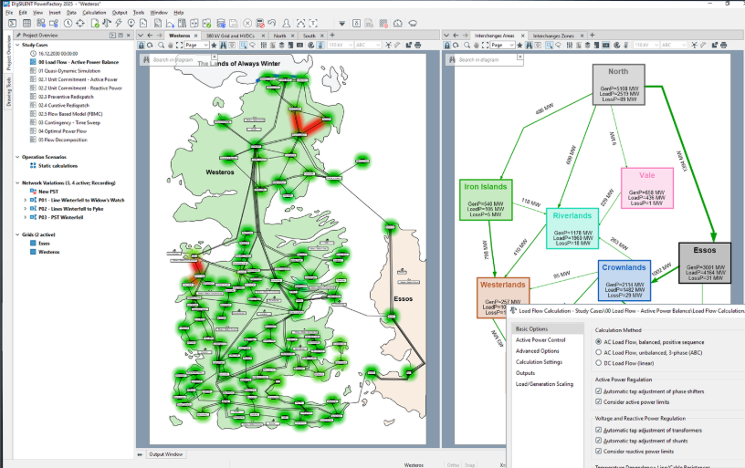
3. PowerFactory learnings
Load flow analysis
Steady state analysis of a power system network
A starting point for further simulations
Procedure was learnt
Videos watched on more simulation types
[2]

Slide 7
4. Further work
Gather a list of required data from other teams:
Siting team: voltage lines and infra available
Storage: sizing, battery management
Electrical Drive Train: given PMSG is fixed
Learn outdated and state-of-the-art technology from S. Heier
Study more operation modes

Slide 8
Bibliography – Grid Code Development
[1] SYRRIAN ARAB REPUBLIC / Ministry of Electricity / PETE / Transmission Grid Code, 2014 (accessed Sept. 27, 2025)
[2] “PowerFactory - DIgSILENT,” www.digsilent.de. https://www.digsilent.de/en/load-flow-analysis.html (accessed Sept. 27, 2025)
‌

